Slide 1

UPI FRAUD DETECTION USING MACHINE LEARNING
by
S. Jaheda
Roll No. 214G1A3229
G. Afra Tahaseen
Roll No. 214G1A3202
K. Divya Madhuri
Roll No. 214G1A3219
P. Mohammad Arshad
Roll No. 214G1A3253
Under the guidance of
Ms. P. Sirisha _{M. Tech.}
Assistant Professor
Department of Computer Science and Engineering (Data Science)
Srinivasa Ramanujan Institute of Technology
(Affiliated to JNTUA & Approved by AICTE) (Accredited by NAAC with ‘A’ Grade & Accredited by NBA (EEE, ECE & CSE)
Rotarypuram Village, B K Samudram Mandal, Ananthapuramu – 515701.
2024 - 2025

Slide 2
Abstract
The rapid adoption of Unified Payments Interface (UPI) for digital transactions has increased the risk of fraudulent activities, posing challenges to financial security and user trust. This research addresses the problem of UPI fraud detection by analyzing transaction details such as the bank book name, transaction ID, and transaction amount, with the goal of accurately classifying transactions as either "Transaction Failed: Incorrect Details Entered" or "Transaction Successful: Details Verified and Processed." To achieve this, a Random Forest Classifier, known for its accuracy and resilience against overfitting, was implemented to process these transaction details. The model's evaluation demonstrated its effectiveness in distinguishing between genuine and fraudulent transactions, achieving high accuracy. These findings suggest that the proposed approach can enhance UPI transaction security, ensuring seamless processing of legitimate transactions while providing users with an additional layer of protection against unauthorized activities.

Slide 3

Contents
Abstract
Introduction
Literature survey
Proposed Work
References
GitHub Link
Queries

Slide 4
Introduction
What is UPI?
Unified Payments Interface (UPI) is a real-time digital payment system facilitating instant transactions.
The Rise of UPI Fraud
With the rapid growth of UPI, the risk of fraudulent activities has increased significantly.
Fraud includes unauthorized transactions, incorrect details, and manipulated data.
Types of UPI Fraud
Phishing attacks
Malware attacks
SIM Cloning

Slide 5
Introduction
Need for Fraud Detection
To identify and prevent fraudulent activities in UPI transactions.
To ensure the smooth processing of legitimate transactions and enhance user trust.
Why Random Forest?
A Machine learning algorithm with:
High accuracy and precision for classification tasks.
Strong resistance to overfitting, ensuring reliability on large datasets.
Ability to effectively identify patterns that differentiate fraudulent and legitimate transactions.

Slide 6
Literature Survey
No | Title | Author | Journal Name & Year | Methodology Adapted | Key Findings | Gaps
1. | Fraud Detection in UPI Transactions Using Machine Learning | J. Kavitha, G. Indira, A. Anil kumar , A. Shrinita , D. Bappan | EPRA International Journal of Research and Development (IJRD),April -2024 | Machine Learning Techniques | machine learning (ML) techniques like SVM | Limited availability of diverse, real-world datasets and scalability for high transaction volumes
2. | UPI fraud Detection using Machine Learning | Yash Patil, Amar Shinde, Yash Parthe, Sameer Sayyad | International Research Journal of Modernization in Engineering Technology and Science , September-2024 | Machine Learning Techniques | Multi-Model Approaches Hidden Markov Models (HMM), K-means Clustering | Limited Dataset Generalization

Slide 7
Proposed System
Detection Model
Multiple Decision Trees: Random Forest creates a robust fraud detection model by building multiple decision trees. Each tree learns from different subsets of data and features, helping the system classify transactions as fraudulent or legitimate. Each tree provides its own classification (fraud or legitimate), and the Random Forest aggregates these results to make the final decision.
Real-Time Detection
Instant Analysis: Random Forest can process and analyze UPI transaction data in real time, detecting fraudulent activities as they occur. This ensures quick identification of suspicious transactions, allowing for immediate action

Slide 8
Proposed System
Prevention
Proactive Fraud Prevention: Historical transaction data helps the model learn patterns that are indicative of fraud. Random Forest identifies these patterns early on, allowing the system to proactively flag or block potentially fraudulent transactions before they occur.
Prevent Fraud or Not: By analyzing known fraud patterns, the system can prevent fraud or not by blocking suspicious transactions that resemble previous fraudulent activities.
Enhanced Accuracy
Improved Predictions: The ensemble nature of Random Forest ensures more accurate predictions by averaging multiple decision trees’ decisions, reducing the risk of overfitting, and improving the model’s reliability in classifying transactions.

Slide 9
Proposed System
Fraud or Not with High Accuracy: Random Forest’s ability to combine multiple models’ predictions enhances its ability to detect fraud or not, even in complex or noisy data.
Advantages:
Random Forest is capable of performing both Classification and Regression tasks.
It is capable of handling large datasets with high dimensionality.
Handles missing data well.
It enhances the accuracy of the model and prevents the overfitting issue.

Slide 10
Reference
[1]. Rupa Rani, Adnan Alam, Abdul Javed, “Secure UPI: Machine Learning-Driven Fraud Detection System for UPI Transactions”, IEEE | April 2024 .
[2]. Yash Patil, Amar Shinde, Yash Parthe, Sameer Sayyad “UPI fraud Detection using Machine Learning”, International Research Journal of Modernization in Engineering Technology and Science , Volume:06/Issue:09/September-2024.
[3]. J. Kavitha, G. Indira, A. Anil kumar , A. Shrinita , D. Bappan, “ Fraud Detection in UPI Transactions Using Machine Learning” EPRA International Journal of Research and Development (IJRD),April -2024

Slide 11
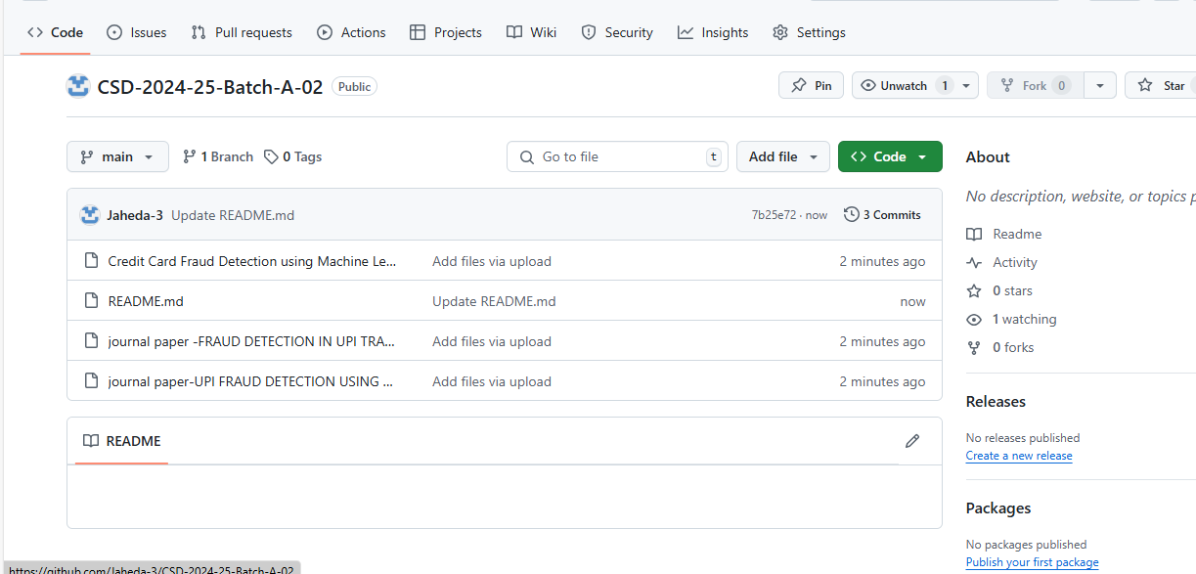
GITHUB LINK

Slide 12
Any Queries?

Slide 13
Thank You!!!

